Slide 1
Cryptography and Network Security Chapter 13
Digital Signatures
Arabic Language Audio Comments by
Prof. Mohamed Ashraf Madkour
Fifth Edition
by William Stallings
Lecture slides by
Lawrie Brown
Notes:
Lecture slides by Lawrie Brown for “Cryptography and Network Security”, 5/e, by William Stallings, Chapter 12 – “Message Authentication Codes”.

Slide 2
Overview of Digital Signatures
have looked at message authentication
but does not address issues of lack of trust
digital signatures provide the ability to:
verify author, date & time of signature
authenticate message contents
be verified by third parties to resolve disputes
hence include authentication function with additional capabilities
Notes:
One of the most fascinating and complex areas of cryptography is that of message authentication and the related area of digital signatures. We now consider how to protect message integrity (ie protection from modification), as well as confirming the identity of the sender. Generically this is the problem of message authentication, and in eCommerce applications is arguably more important than secrecy. Message Authentication is concerned with: protecting the integrity of a message, validating identity of originator, & non-repudiation of origin (dispute resolution). There are three types of functions that may be used to produce an authenticator: a hash function, message encryption, message authentication code (MAC). Hash functions, and how they may serve for message authentication, are discussed in Chapter 11. The remainder of this section briefly examines the remaining two topics. The remainder of the chapter elaborates on the topic of MACs.

Slide 3
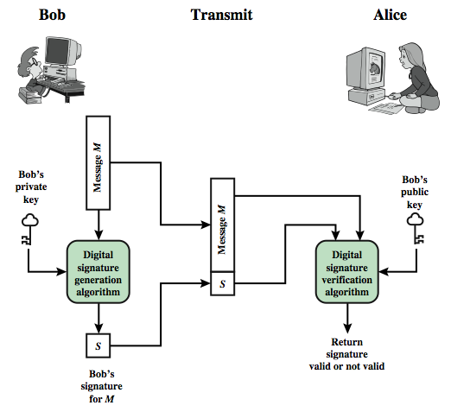
Digital Signature Model
Notes:
One of the most fascinating and complex areas of cryptography is that of message authentication and the related area of digital signatures. We now consider how to protect message integrity (ie protection from modification), as well as confirming the identity of the sender. Generically this is the problem of message authentication, and in eCommerce applications is arguably more important than secrecy. Message Authentication is concerned with: protecting the integrity of a message, validating identity of originator, & non-repudiation of origin (dispute resolution). There are three types of functions that may be used to produce an authenticator: a hash function, message encryption, message authentication code (MAC). Hash functions, and how they may serve for message authentication, are discussed in Chapter 11. The remainder of this section briefly examines the remaining two topics. The remainder of the chapter elaborates on the topic of MACs.

Slide 4
Digital Signature Requirements
must depend on the message signed
must use information unique to sender
to prevent both forgery and denial
must be relatively easy to produce
must be relatively easy to recognize & verify
be computationally infeasible to forge
with new message for existing digital signature
with fraudulent digital signature for given message
be practical save digital signature in storage
Notes:
One of the most fascinating and complex areas of cryptography is that of message authentication and the related area of digital signatures. We now consider how to protect message integrity (ie protection from modification), as well as confirming the identity of the sender. Generically this is the problem of message authentication, and in eCommerce applications is arguably more important than secrecy. Message Authentication is concerned with: protecting the integrity of a message, validating identity of originator, & non-repudiation of origin (dispute resolution). There are three types of functions that may be used to produce an authenticator: a hash function, message encryption, message authentication code (MAC). Hash functions, and how they may serve for message authentication, are discussed in Chapter 11. The remainder of this section briefly examines the remaining two topics. The remainder of the chapter elaborates on the topic of MACs.

Slide 5
Direct Digital Signatures
involve only sender & receiver
assumed receiver has sender’s public-key
digital signature made by sender signing entire message or hash with private-key
can encrypt using receiver's public-key
important that sign first then encrypt message & signature
security depends on sender’s private-key
Notes:
The term direct digital signature refers to a digital signature scheme that involves only the communicating parties (source, destination). It is assumed that the destination knows the public key of the source. Direct Digital Signatures involve the direct application of public-key algorithms involving only the communicating parties. A digital signature may be formed by encrypting the entire message with the sender’s private key, or by encrypting a hash code of the message with the sender’s private key. Confidentiality can be provided by further encrypting the entire message plus signature using either public or private key schemes. It is important to perform the signature function first and then an outer confidentiality function, since in case of dispute, some third party must view the message and its signature. But these approaches are dependent on the security of the sender’s private-key. Will have problems if it is lost/stolen and signatures forged. The universally accepted technique for dealing with these threats is the use of a digital certificate and certificate authorities. We defer a discussion of this topic until Chapter 14, and focus in this chapter on digital signature algorithms. Also need time-stamps and timely key revocation.

Slide 6
Digital Signature Standard (DSS)
US Government approved the DSS signature scheme designed by NIST & NSA in early 90's
published as FIPS-186 in 1991 and revised in 1993, 1996 & then 2000
uses the SHA hash algorithm
DSS is the standard, DSA is the algorithm
FIPS 186-2 (2000) includes alternative RSA & elliptic curve signature variants
DSA is digital signature only unlike RSA which is a public-key technique
Notes:
DSA is the US Govt approved signature scheme, which is designed to provide strong signatures without allowing easy use for encryption. The National Institute of Standards and Technology (NIST) published Federal Information Processing Standard FIPS 186, known as the Digital Signature Standard (DSS). The DSS makes use of the Secure Hash Algorithm (SHA) described in Chapter 12 and presents a new digital signature technique, the Digital Signature Algorithm (DSA). The DSS was originally proposed in 1991 and revised in 1993 in response to public feedback concerning the security of the scheme. There was a further minor revision in 1996. In 2000, an expanded version of the standard was issued as FIPS 186-2. This latest version also incorporates digital signature algorithms based on RSA and on elliptic curve cryptography. In this section, we discuss the original DSS algorithm. The DSS uses an algorithm that is designed to provide only the digital signature function. Unlike RSA, it cannot be used for encryption or key exchange. Nevertheless, it is a public-key technique.

Slide 7
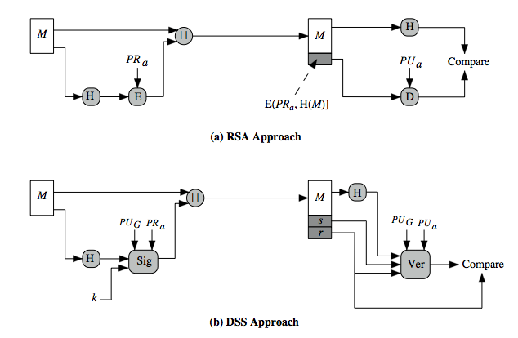
DSS vs RSA Signatures
Notes:
DSA is the US Govt approved signature scheme, which is designed to provide strong signatures without allowing easy use for encryption. The National Institute of Standards and Technology (NIST) published Federal Information Processing Standard FIPS 186, known as the Digital Signature Standard (DSS). The DSS makes use of the Secure Hash Algorithm (SHA) described in Chapter 12 and presents a new digital signature technique, the Digital Signature Algorithm (DSA). The DSS was originally proposed in 1991 and revised in 1993 in response to public feedback concerning the security of the scheme. There was a further minor revision in 1996. In 2000, an expanded version of the standard was issued as FIPS 186-2. This latest version also incorporates digital signature algorithms based on RSA and on elliptic curve cryptography. In this section, we discuss the original DSS algorithm. The DSS uses an algorithm that is designed to provide only the digital signature function. Unlike RSA, it cannot be used for encryption or key exchange. Nevertheless, it is a public-key technique.

Slide 8
Digital Signature Algorithm (DSA)
creates a 320 bit signature
with 512-1024 bit security
smaller and faster than RSA
a digital signature scheme only
security depends on difficulty of computing discrete logarithms
Notes:
The DSA is based on the difficulty of computing discrete logarithms (see Chapter 8) and is based on schemes originally presented by ElGamal [ELGA85] and Schnorr [SCHN91]. The DSA signature scheme has advantages, being both smaller (320 vs 1024bit) and faster (much of the computation is done modulo a 160 bit number), over RSA. Unlike RSA, it cannot be used for encryption or key exchange. Nevertheless, it is a public-key technique

Slide 9
Summary
have discussed:
digital signatures
digital signature algorithm and standard
Notes:
Chapter 13 summary

